Slide 1
Outreach
SS Roach. Team 5 PM.
Emmanuel Menier
Leonardo Orea-Amador
Ivan Perez
Jaime Salas

Slide 2
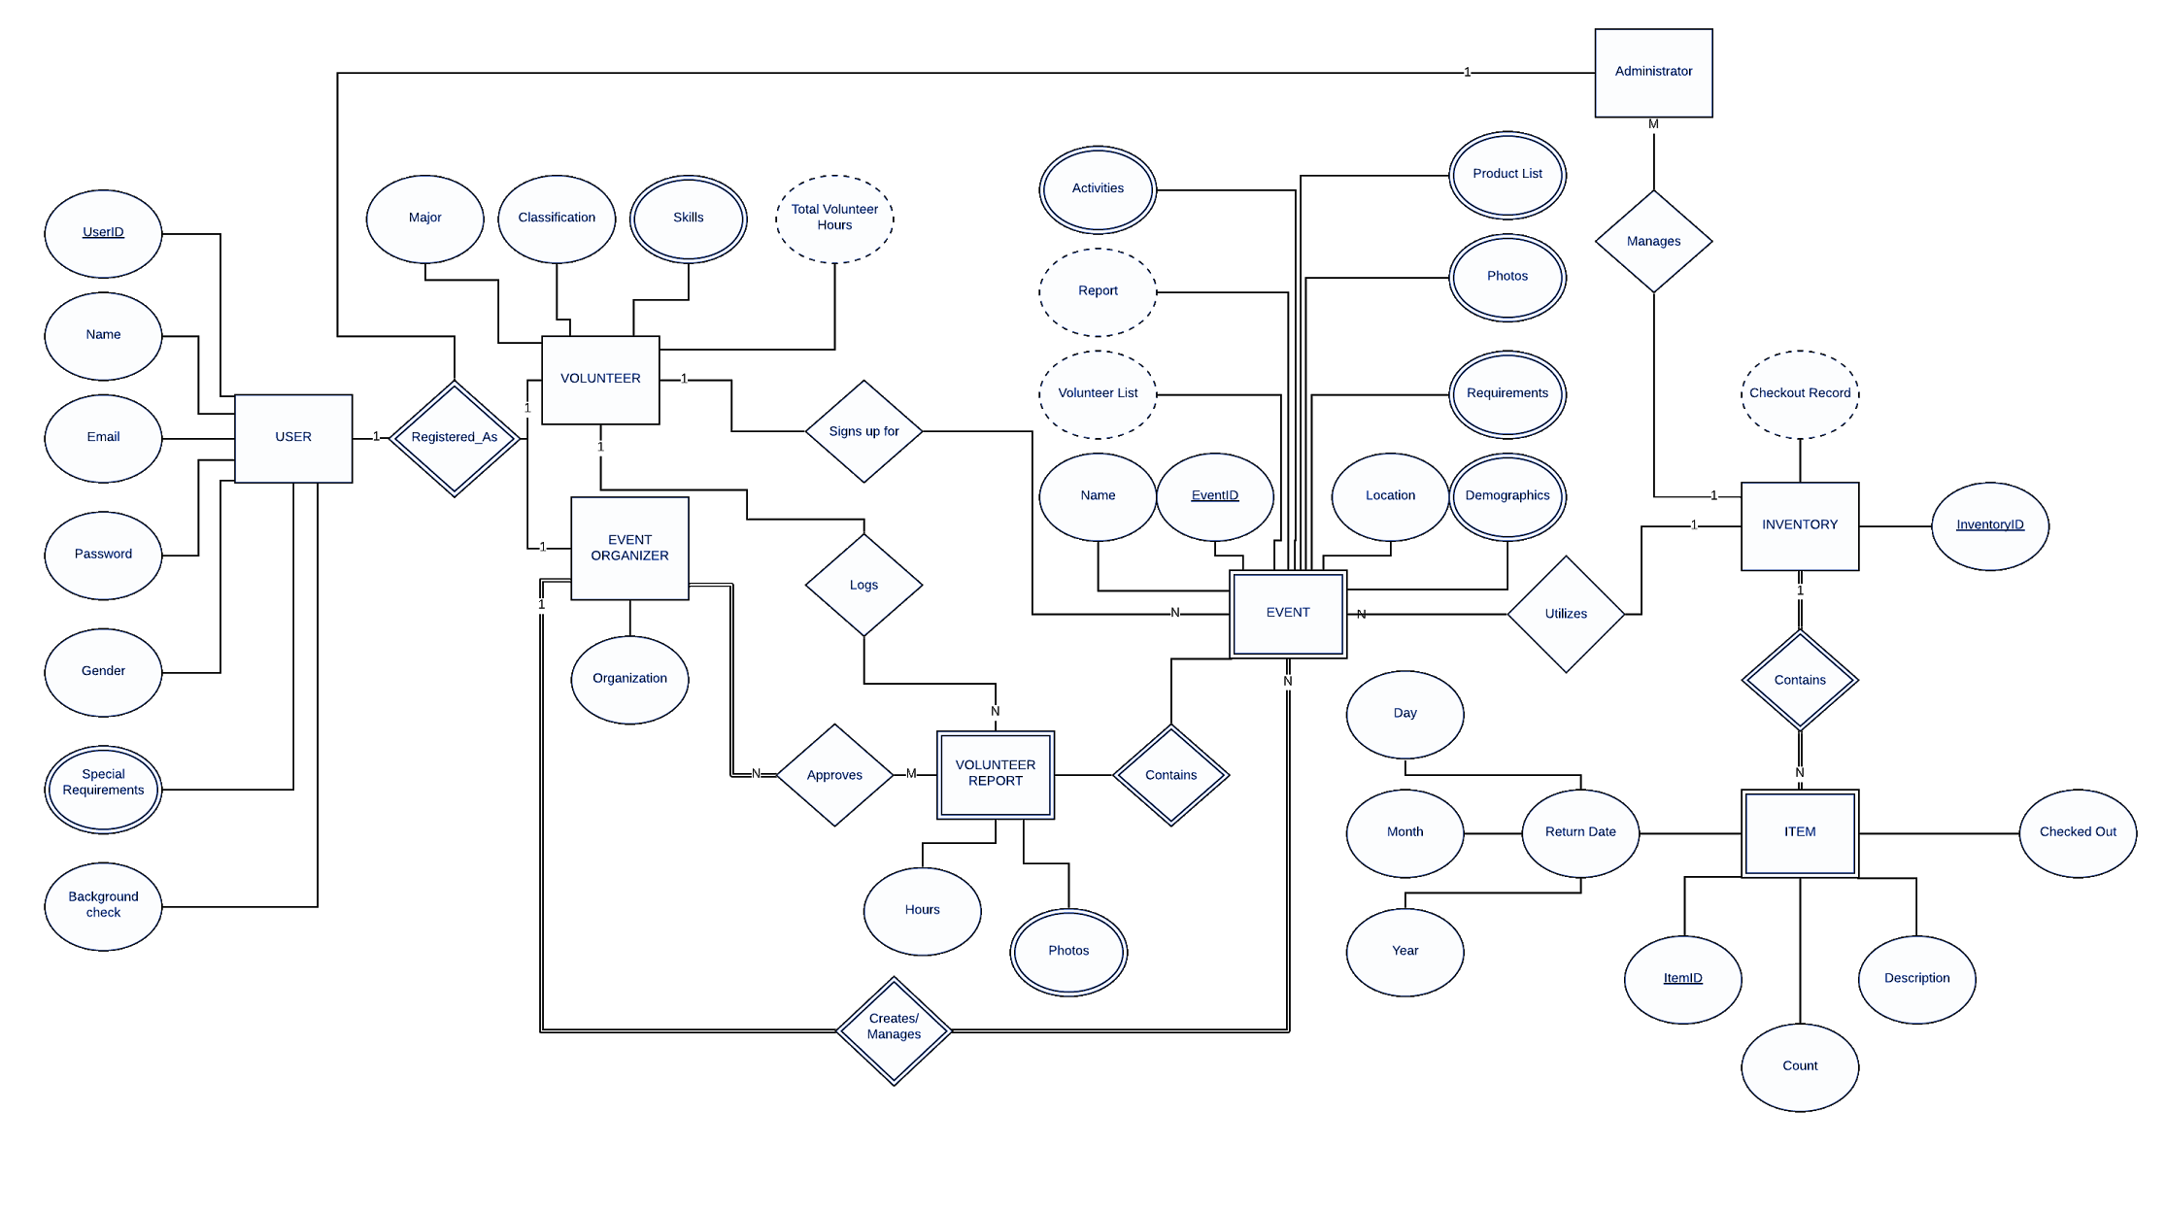
ER Diagram

Slide 3
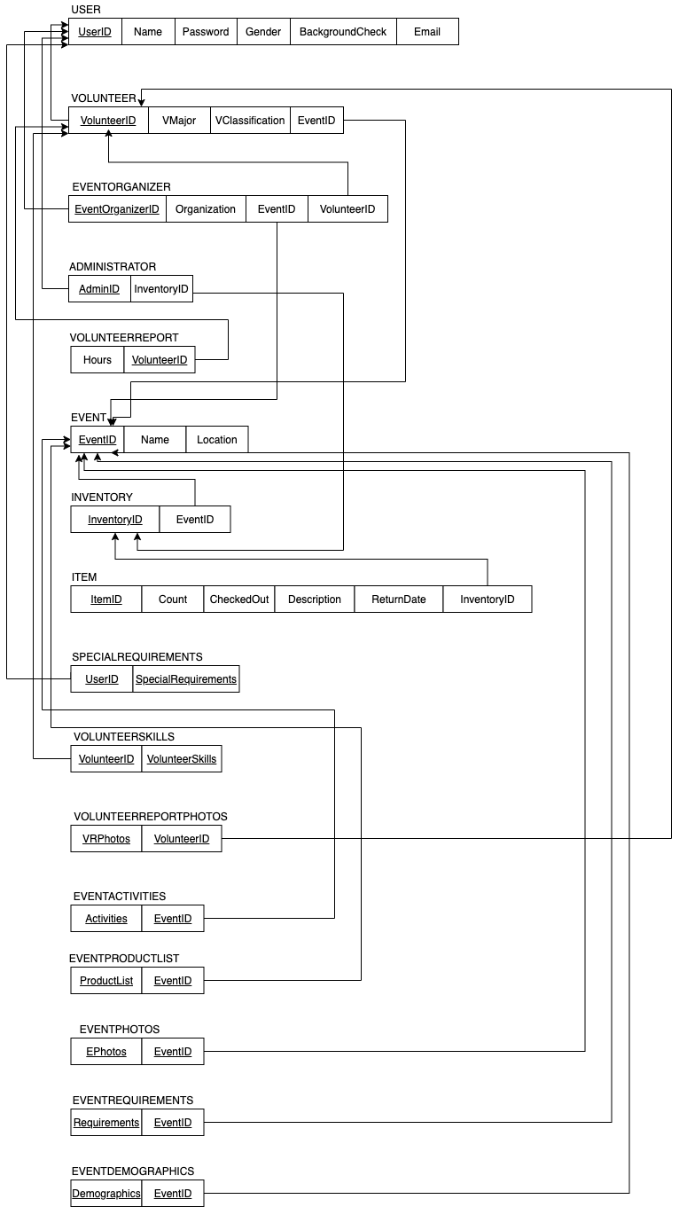
Relational Diagram

Slide 4
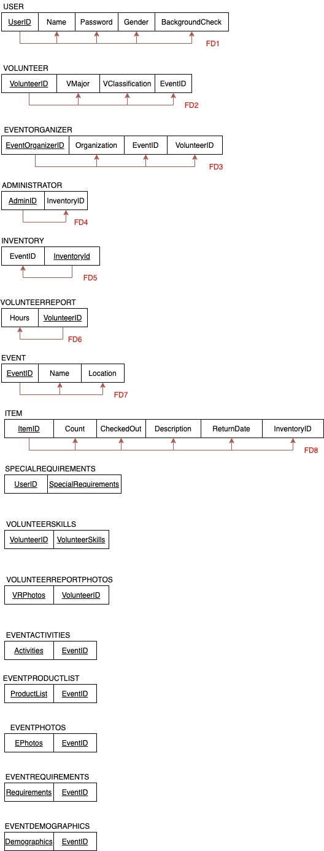
Normalized Relational
Diagram

Slide 5
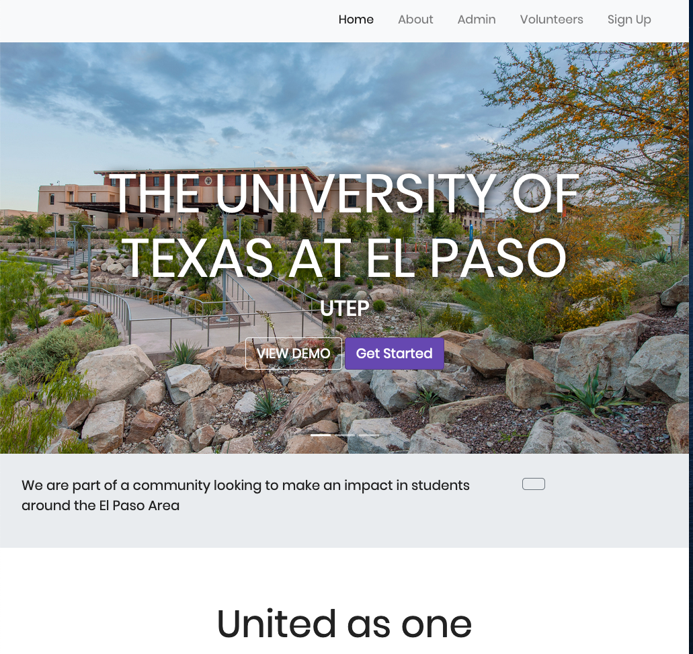
Graphic User Interface

Slide 6
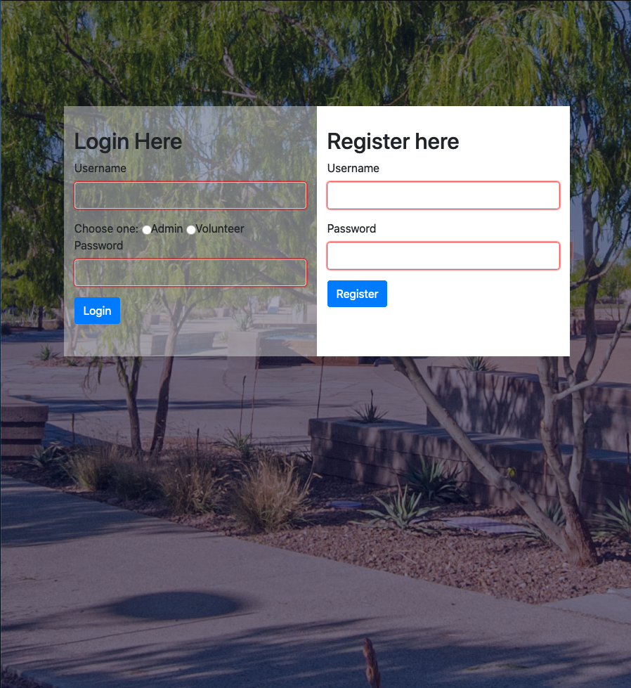
Login Page

Slide 7
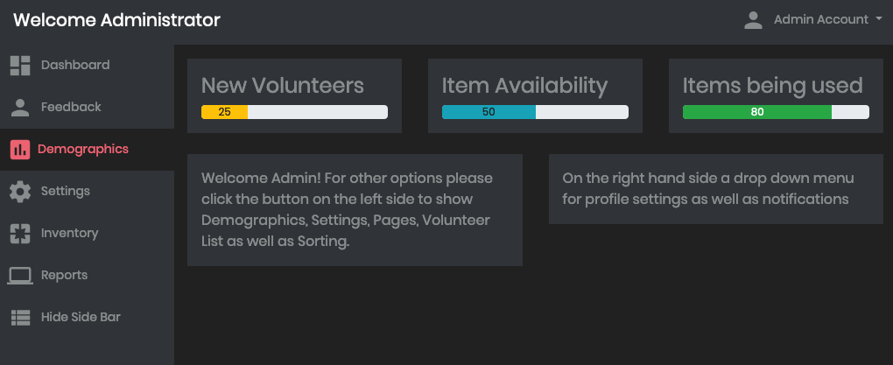
Administrator Page

Slide 8
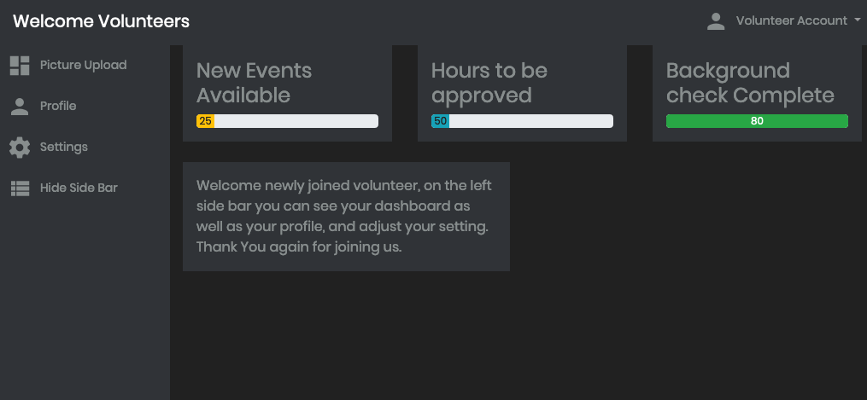
Volunteer Page

Slide 9
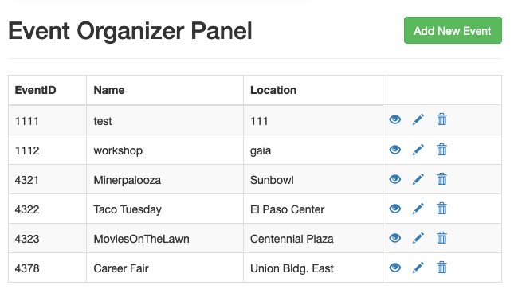
Event Organizer Page

Slide 10
Appendix. Scope
We will develop a system for The University of Texas at El Paso’s Computer Science Department to aid in the tracking of volunteer hours and promote awareness of Outreach events and create reports. The goal is to manage community service hours, future and past events, and demographics of event turnout. The system will provide information about events where volunteer hours may be available, how many volunteer hours a student has completed, how many hours all students have completed, and volunteer’s information(skills, genders, ID, languages, classification, name, email, volunteer hours) in a profile. The website will follow UTEP design rules and regulations which can be found at https://www.utep.edu/university-communications/resources/graphic-identity-guide.html.
The system will provide a way for faculty, administration, and students to log in and view corresponding information. Faculty will be able to access all volunteer information, verify volunteer events, and promote said events. Volunteers will be able to log their volunteer hours, sign up for new events, view their current volunteer hours, as well as repeal the sign up for an event upon admin approval. The administration will be able to upload new events, promote them, and make sure logged hours for events are accurate. Any UTEP student can have access to this portal but are limited to event requirements that event organizers see fit.
Notes:
We will develop a system for the university of texas at el paso’s computer sciece deparment to aid in the task of managing events and their participats
The system will faciliate tracking events, and their details like event name, location, requirements.
Similarly, it will track the information of participants such as event organizers and volunteers by tracking their service hours, as well as their information such as name, email, id number, demographics etc.
The website is to adhere to the guidelines of UTEP web design and rules
Similarly, the system will provide a log in interface for faculty, administration, and students as users which then will adopt the roles in the hierchy of administrator, event organizer, and volunteer, with the higher ranks being able to take participate in the lower ranks as well.
The main responsibility of users in the role of administrators will be able to access all volunteer information, verify volunteer events and promote said events.
Administrators will also be able to create and manage events
Then, event organizers will be able to manage their assigned events and approve hours and flow of inventory items, but only for their assigned events
While Volunteers will be able to log in, upload pictures, and report their service hours
Event organizers and Administrators will be able to obtain reports of all events or on a by-event basis.
In summary, this system will enable events management, volunteer service tracking, and reporting

Slide 11
Appendix. Requirements 1-10
The system shall keep a documentation record of events.
The system shall be able to organize and describe individual events.
The system shall allow admins to manage, edit, and delete the events.
The system shall allow admins to sign in and manage events
The system shall allow students to sign up as members for specific events.
The system shall be able to capture optional or required information of the event members like age, classification, ID numbers, college, etc.
The system shall be able to annotate the requirements for the event attendees such as writing material, equipment, or other types of required equipment.
The system shall be able to capture special requirements from the attendees (e.g. wheelchair, gluten-free, etc).
The system shall allow the member attendees to report their attendance and participation hours.
The system shall allow the admins to approve the member attendance reports based on their participation hours.

Slide 12
Appendix. Requirements 11-21
11. The system shall keep track of all hours reported by the members.
12. The system shall keep a record of activities realized at the event or any worthwhile incident.
13. The system shall be able to create and distribute a log of pictures taken during the event.
14. The system shall allow the event members to upload pictures to their respective events
15. The system shall keep track of the total number of attendees for every event and be able to deliver reports of attendance.
16. The system must keep track of where the impact is being made the most, and what areas are being visited the most.
17. The system will advertise to students about future events, for students or schools being outreached too.
18. The system will also notify the users whether they require a background check
19. The system shall provide the option to allocate an inventory with items and their description
20. The system shall be able to verify the flow of items, whether the items have been checked in or out from the inventory as well as any important description (e.g. damage or returning date).
21. The system shall have a report function executed by admins which lets them obtain a report by an event.

Slide 13
Appendix. Assumptions
We assume that users will know what roles they have whether they are admins, volunteers, or event coordinators. We assume event budgets are handled outside of the system. We assume background checks can be confirmed in the system but the background check itself won’t be done through the system. We assume all volunteers are students from UTEP and sign in to the system using their UTEP credentials. We assume any special guests or volunteers will be handled by a case to case basis making administrators or other faculty responsible for their account.

Slide 14
Thank You
jj

